Slide 1

STOCK PRICE PREDICTION
Project Code : P421
Group - 2
Project Members :
Mr. Durga Prasa Kamisetti
Imaduddin Khoobtar
Manasvi Dhananjay Bagal
Ashutosh R. Dhakulkar
Ms. Medoju Vaishnavi
Shaik Abdul Khadar

Slide 2



CONTENT
Business Problem
Business Objective
Solutioning Approach
Exploratory Data Analysis
Model Building
Deployment
Challenges Faced

Slide 3
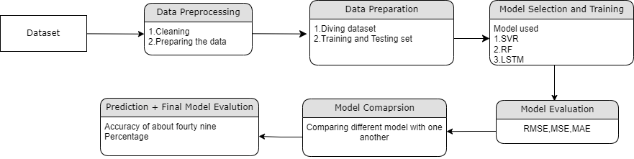
Methodology

Slide 4
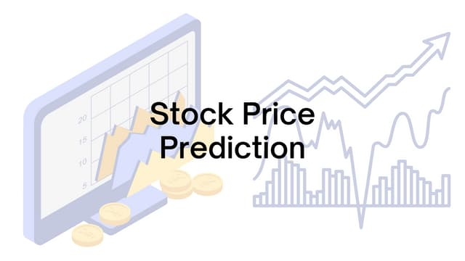
BUSINESS PROBLEM :
Stock Forecast
BUSINESS OBJECTIVE:
Collect historical stock price data.
Preprocess the data to make it suitable for modeling.
Perform exploratory data analysis to understand the data.
Build and evaluate different machine learning models for stock price prediction.
Compare the performance of different models and select the best one.
Project Plan
Solution:
In EDA, we will explore and analyze the dataset to understand its main characteristics, detect patterns, spot anomalies, and check assumptions.
Depending on the problem type, we will choose appropriate algorithms which will give best accuracy. Since this is a regression problem.The LSTM algorithm has the ability to store historical information and is widely used in stock price prediction.
For the deployment part we will be using Streamlit.

Slide 5
Exploratory Data Analysis (EDA):
Data Insights :
Based on our examination of the dataset, we can conclude that it has all the information needed to identify patterns such as uptrends, downtrends, and sideways movements. Analyze trading volume to understand the strength of price movements. Simple Moving Average (SMA), and Exponential Moving Average (EMA) to identify trends. Identify momentum and trend direction etc
Of the seven columns in the dataset, one(Close column) is a target variable, and the remaining columns are features.

Slide 6
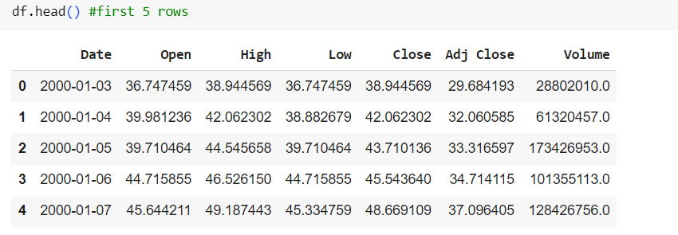
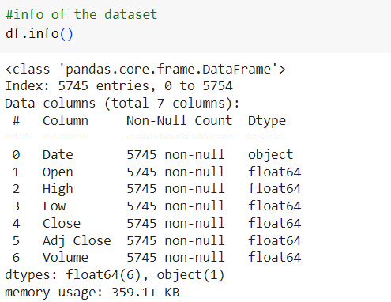
About The Dataset:
DATA :
DATA INFROMATION :

Slide 7
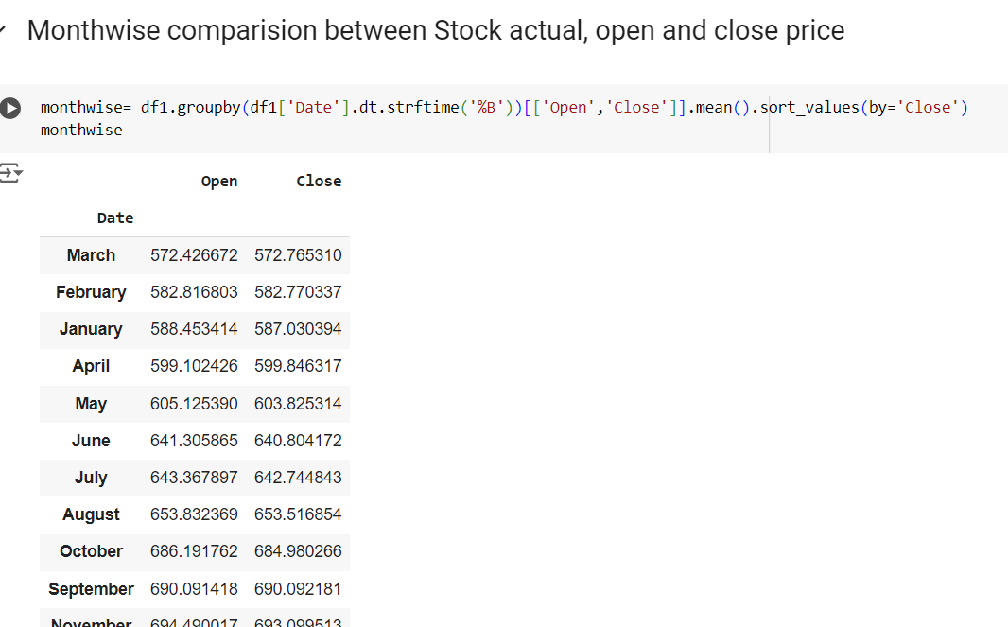
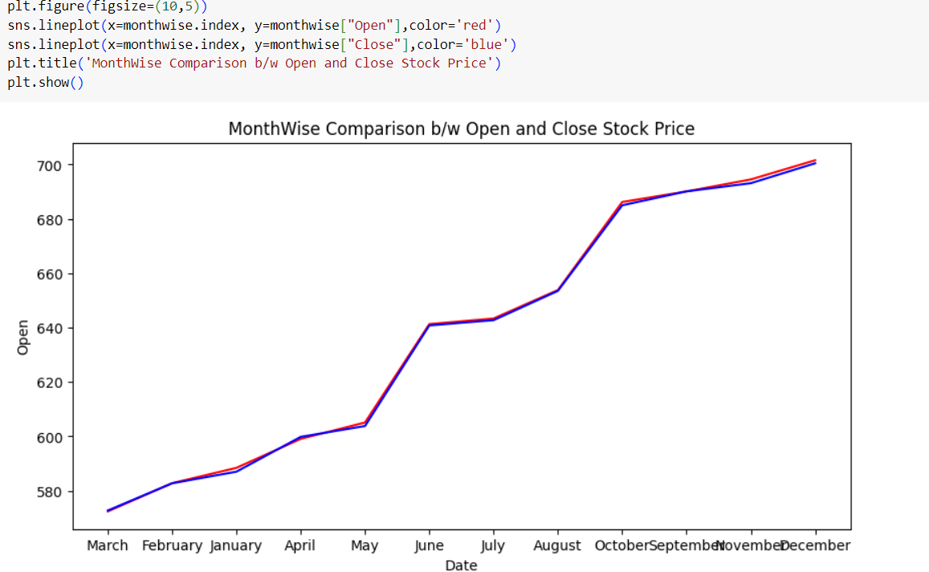
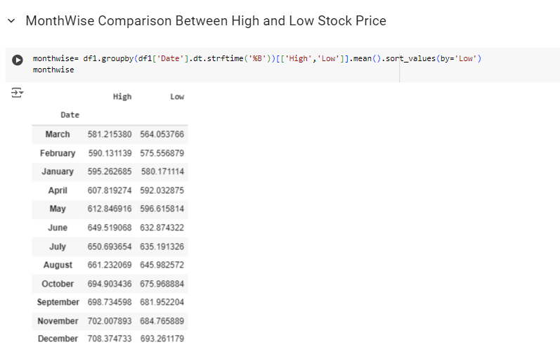
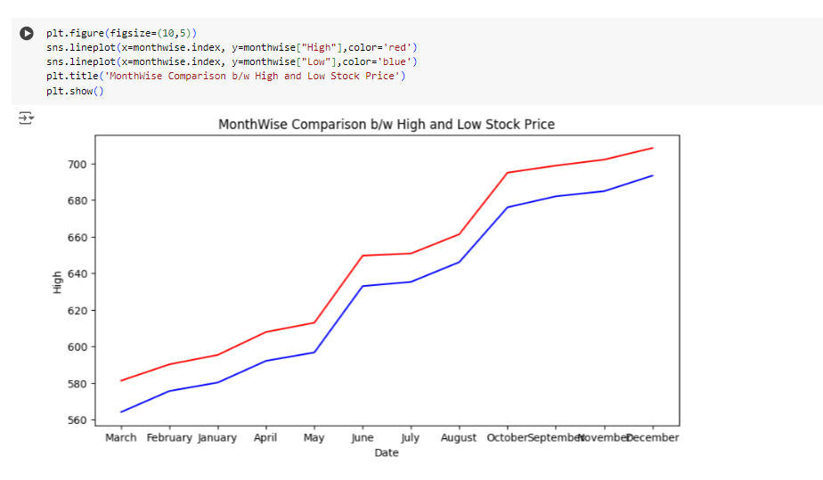

Slide 8
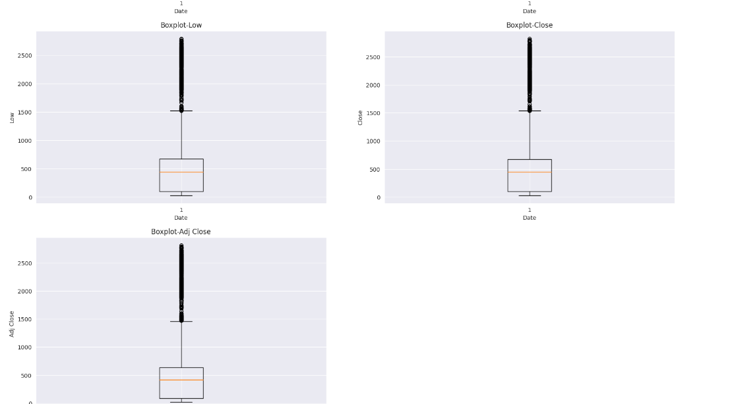
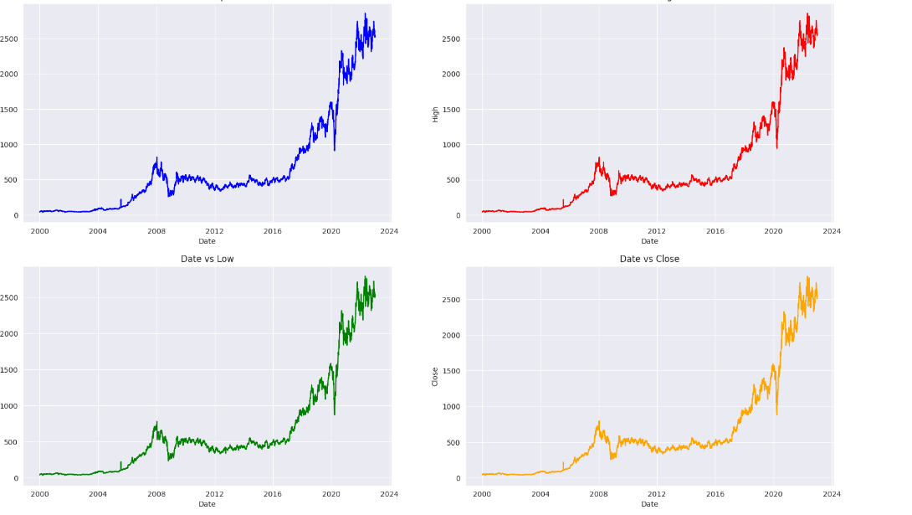
Visualization Line plot Box plot

Slide 9
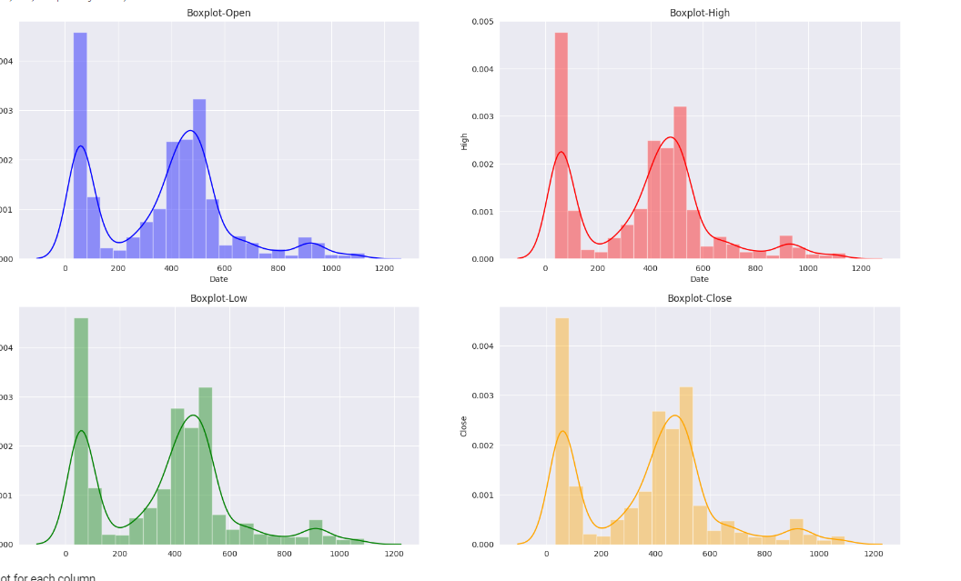
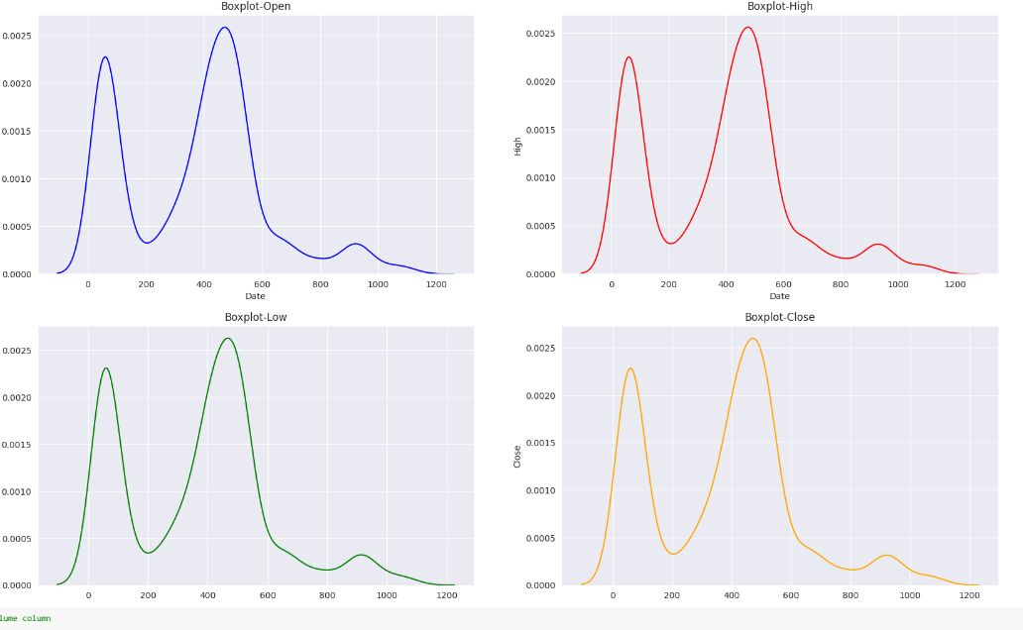
Distribution after caping outliers KDE plot

Slide 10
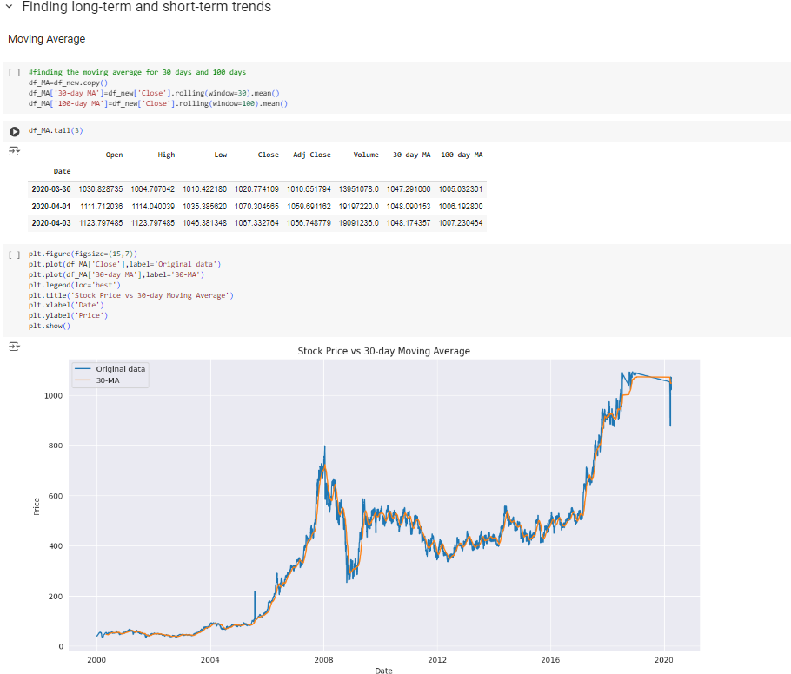
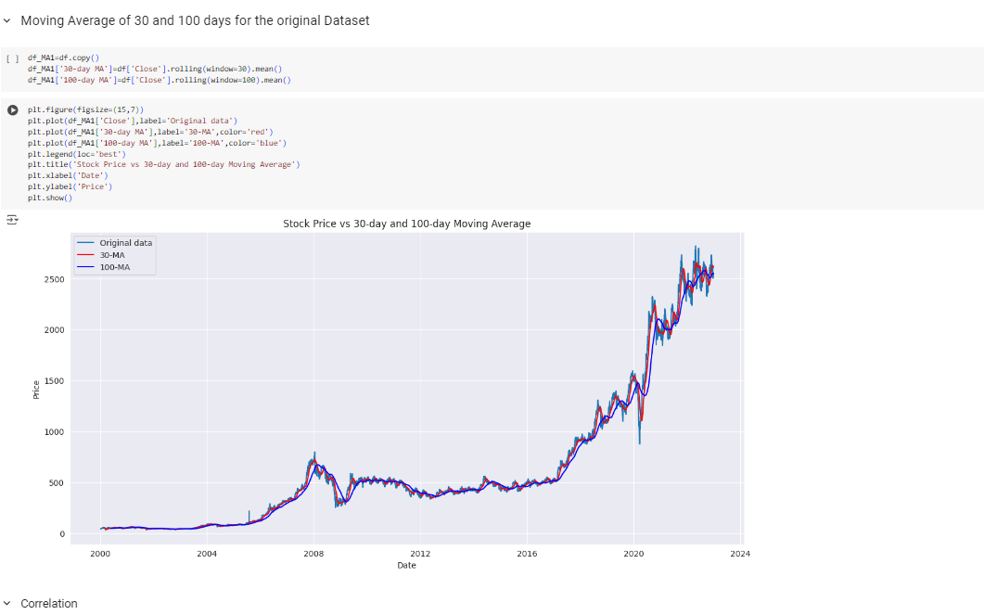

Slide 11
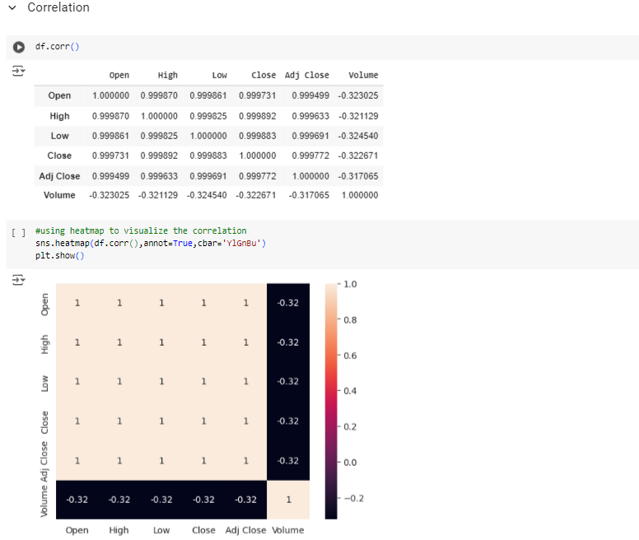
Correlation Analysis
The correlation between 'Open' and 'Close' is very high (0.99), indicating that the opening and closing prices of Reliance stock are closely related. This is expected as the prices do not fluctuate drastically within a single trading day.
The 'Open' price is also highly correlated with the 'High' and 'Low' prices of the day (0.98), suggesting that the opening price is a good indicator of the price range for the day.
There is a slight negative correlation between 'Volume' and stock prices (-0.20 to -0.22). This could imply that on days when a large number of shares are traded, the prices tend to be slightly lower. This might be due to increased selling pressure or other market dynamics.

Slide 12
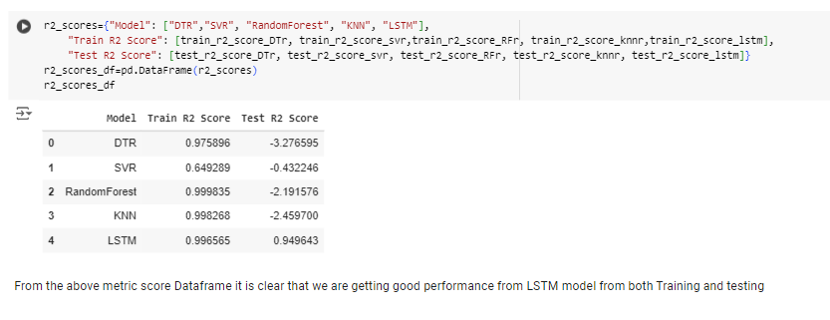
Model Building
In the model building we tried various models mentioned below with the aim to find best accurate model :
Model Name
Decision Tree
KNN
SVR
Grid Search cv
Random forest Regressor
LSTM
By looking at this table we can say that our LSTM model has the best R2 score,
So we are going to use LSTM for deployment.

Slide 13
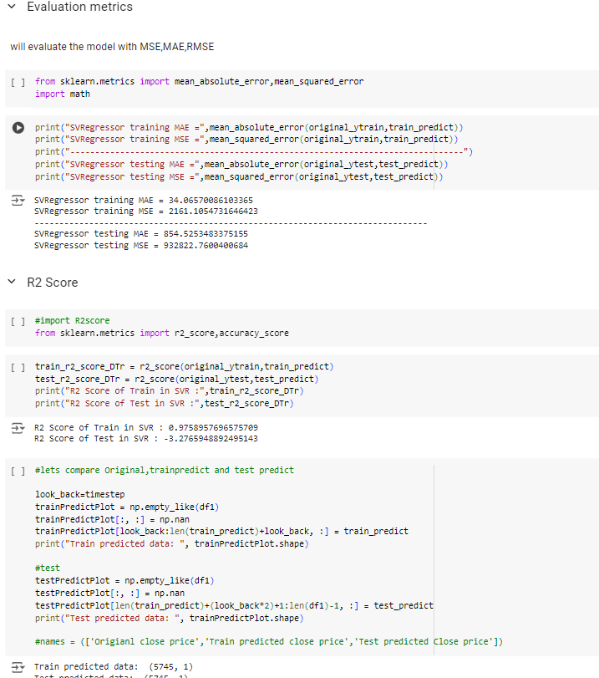
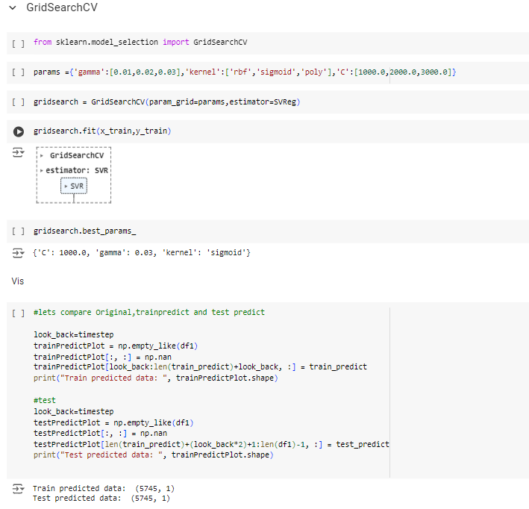
Accuracy Calculation

Slide 14
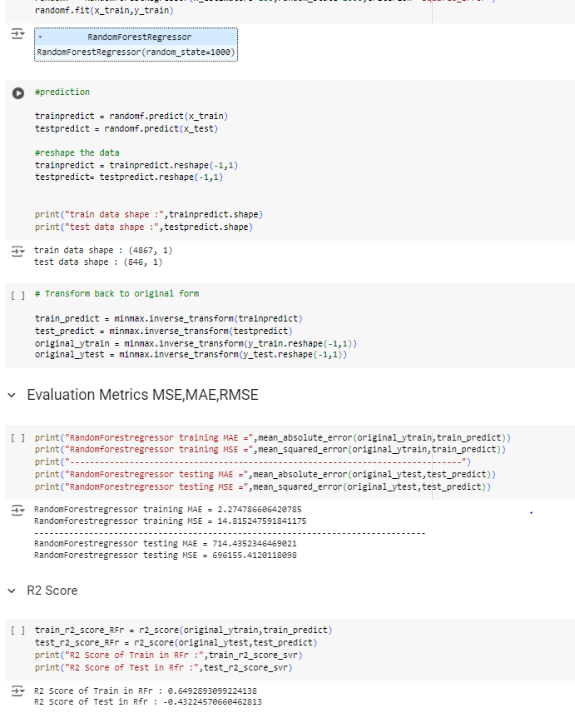
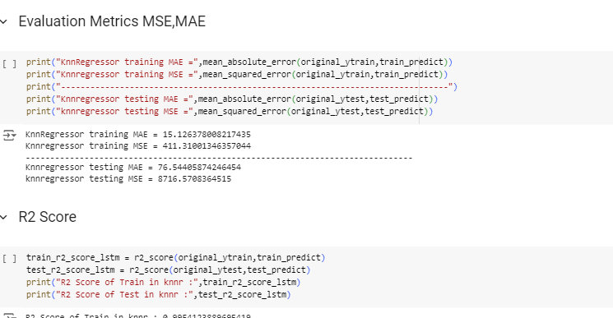

Slide 15
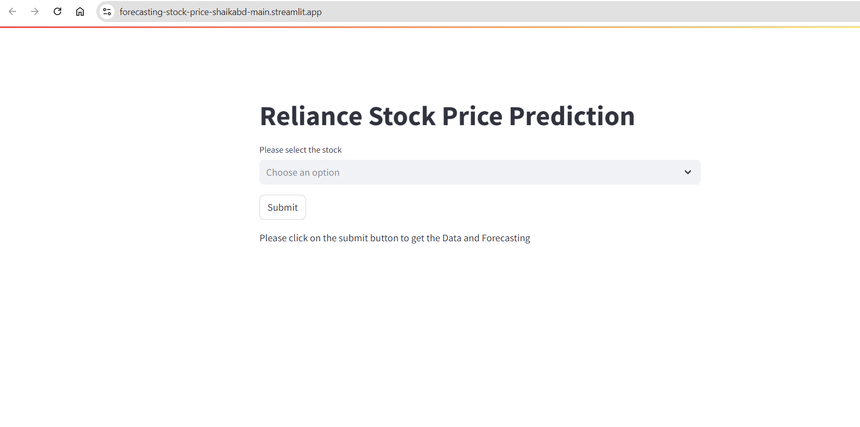
Model Deployment
.

Slide 16
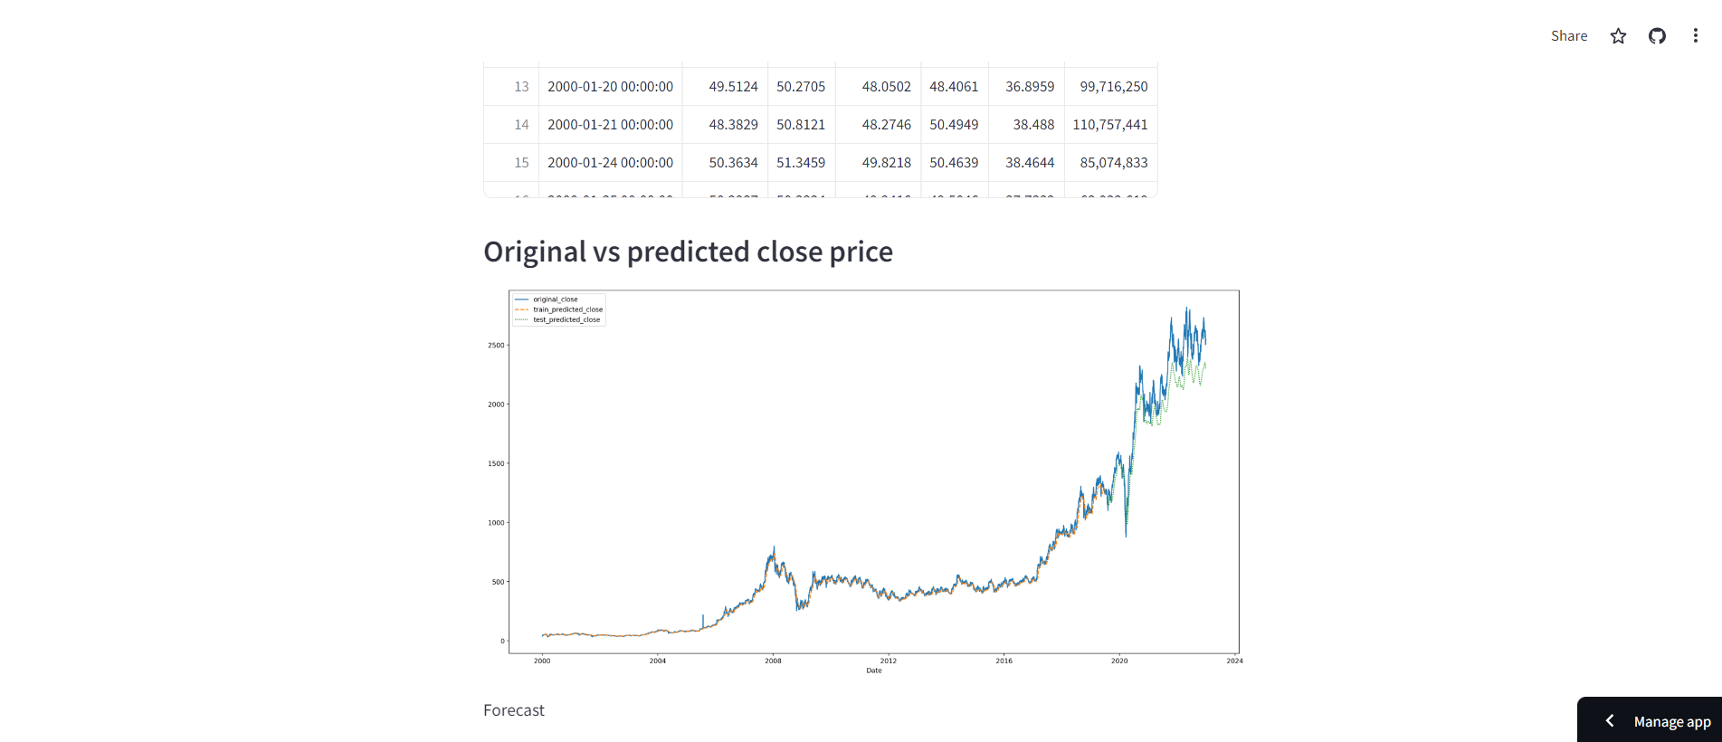

Slide 17
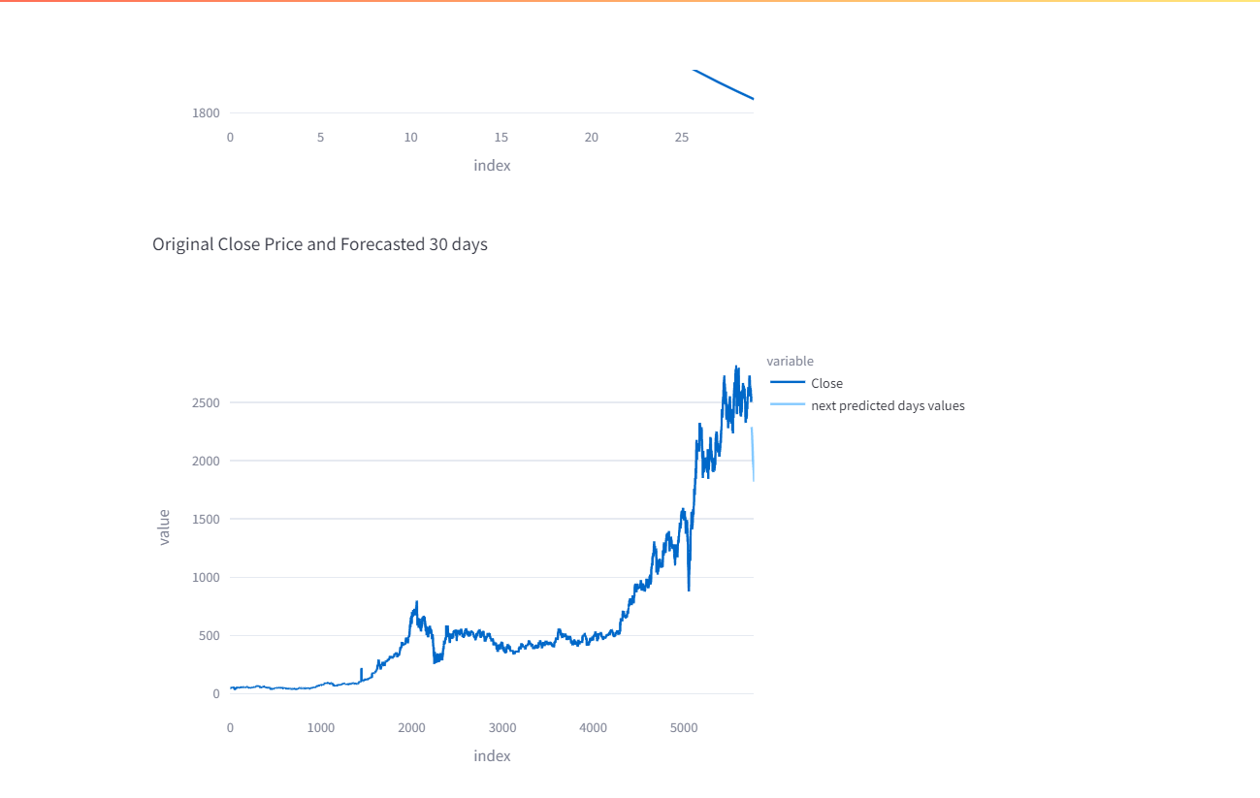
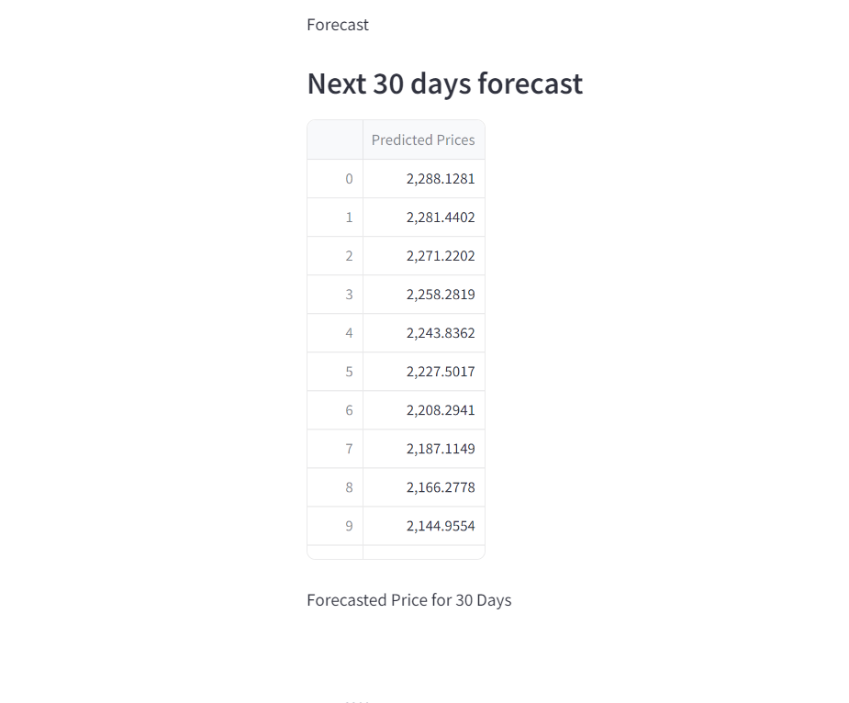

Slide 18
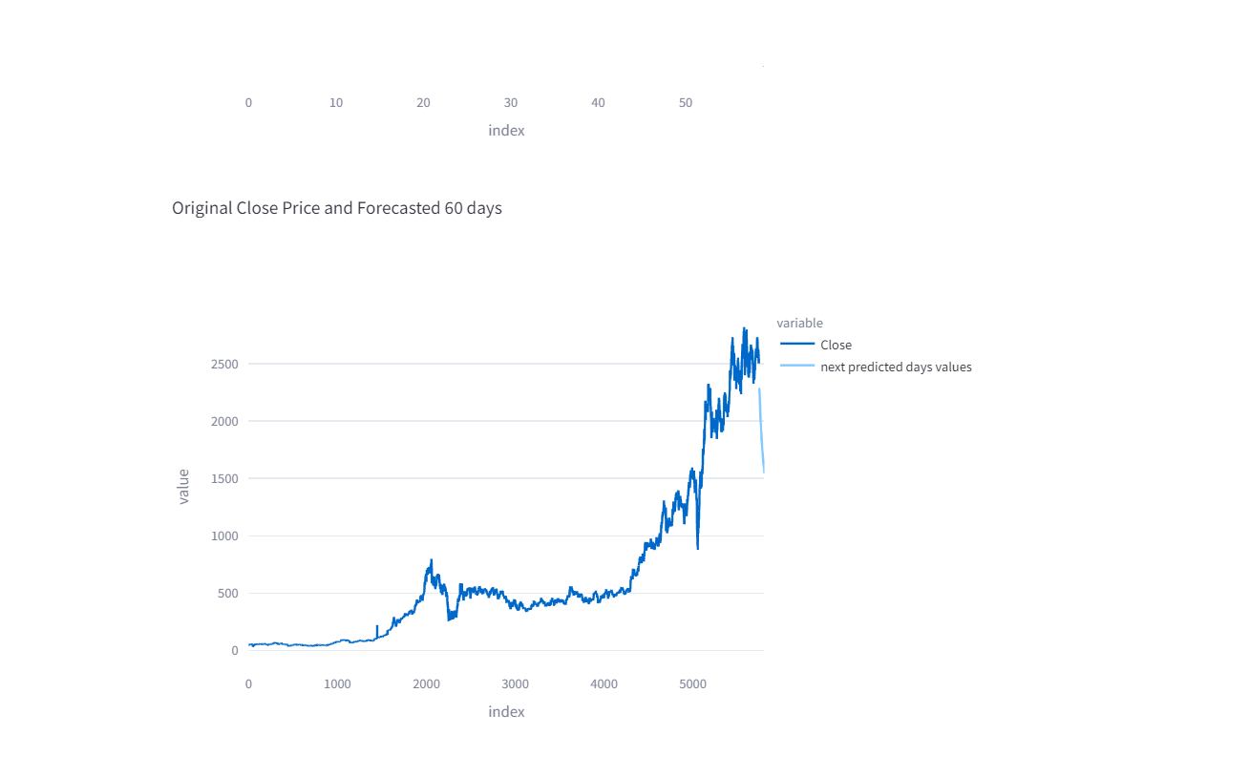
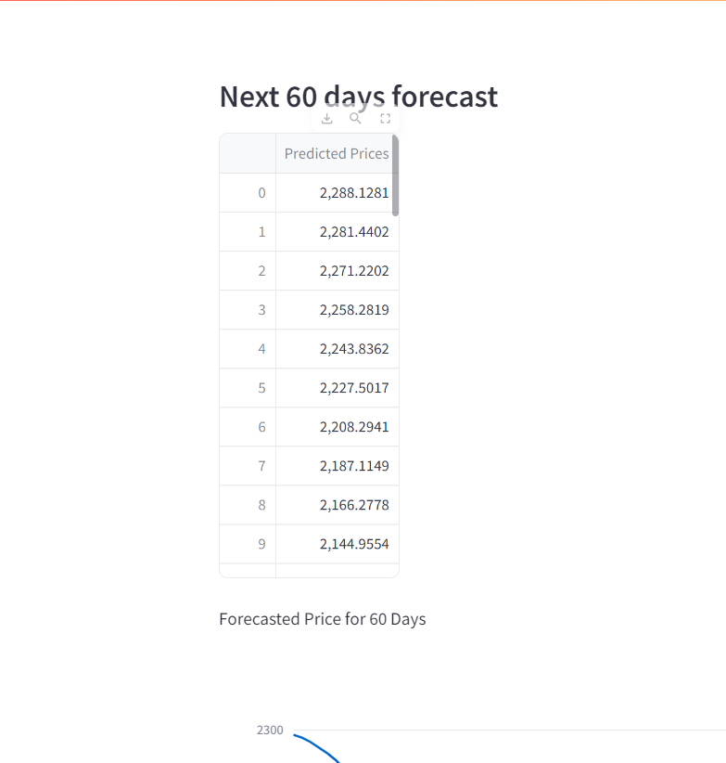

Slide 19
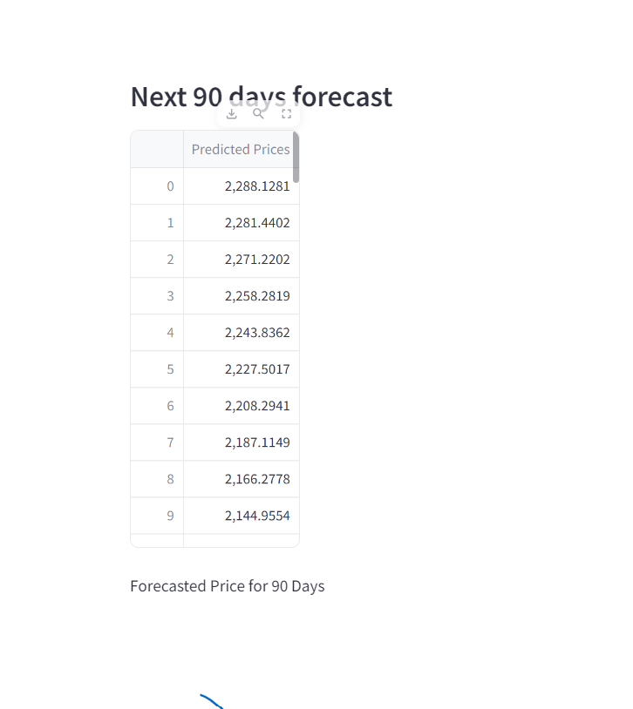
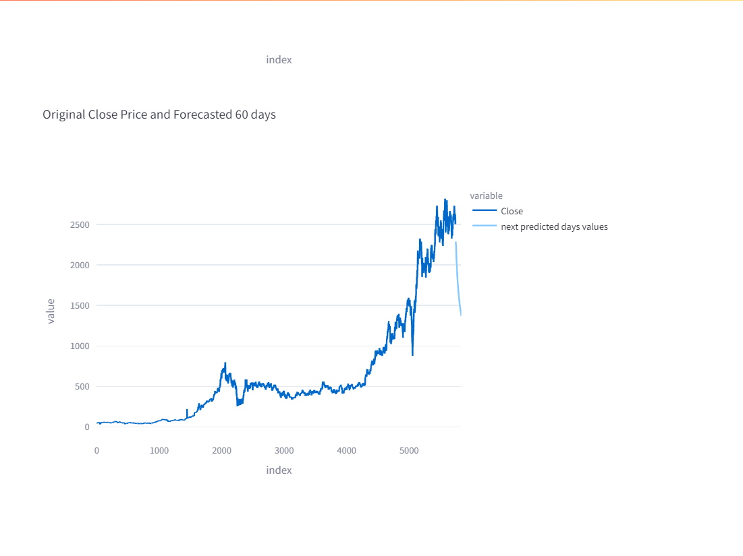


Slide 20
Starting from the Data collection part we imported the necessary libraries and did Data preprocessing. EDA was also a smooth journey for us since the data was already cleaned and had no missing values. Coming towards the Model building, it was quite challenging for us to select which model to use for stock price prediction that would give us the highest accuracy.
Challenges Faced

Slide 21
How Did we overcome it?
While Model building, we tried our dataset on 5 different types of models (LSTM, Random forest regressor, Support vector regression, KNN, and Gated Recurrent Unit) out of which LSTM gave us the highest accuracy and best result. Therefore we finalized our LSTM model and Deployed it successfully using Google Colab and Streamlit.

Slide 22
Thank You

